Slide 1

DriverPass System Analysis
James Soto
Notes:
[No speaker notes required for this slide.]

Slide 2

Functional System Requirements
The system shall validate user credentials when logging in.
The system shall show the progress of each driving class.
The system shall show the progress of each practice test and exam.
The system shall display the user’s information.
The system shall show the driver’s notes.
The system shall display customers special needs.
The system shall show the driver photo.
The system shall show the student photo.
The system shall be updated with new regulations and laws.
Notes:
[In your speaker notes, include an explanation of the different requirements you determined for DriverPass’s system. What are the functional requirements you selected to describe? What are the nonfunctional requirements you selected to describe? Be sure to explain how these requirements meet DriverPass’s needs.]
Our first slide is on your functional system requirements which are essential for the operation of your system. The functional requirements are what we needed to implement to meet your goals. Your system will validate user credentials to log into your web application. Your system will show the student progress after each driving lesson, and it will also show the progress of each practice test and exam. During our meeting you showed us the vision of what you wanted the home page to look like and we believe we met and will exceed your expectations. For your home screen your system will display the following, the user's information, the instructors' notes, any special customer needs, the instructor's photo, the student's photo and any changes from the DMV.

Slide 3
Nonfunctional System Requirements
The system needs to run on all the available platforms so the user or company could access the information from anywhere.
Android App
iOS App
Web browsers, including Google Chrome, Safari, Edge, Firefox
The system needs to be integrated with the server so when information is updated on any of the platforms, the updated information is displayed across the application and other platforms in real time.
The system should be updated regularly to ensure high performance and proper security:
New Security Updates
Reports of Crashing, Bugs and Errors
Modifications to the Layout or UI
Update When New Laws and/or Regulations Come Out
Notes:
[In your speaker notes, include an explanation of the different requirements you determined for DriverPass’s system. What are the functional requirements you selected to describe? What are the nonfunctional requirements you selected to describe? Be sure to explain how these requirements meet DriverPass’s needs.]
In this slide we are looking at the nonfunctional requirements implemented into your system. The system needed to run on all available platforms, which included all the current web browsers and mobile devices, iOS and Android. This allows DriverPass to get their product in as many hands as possible. The system was integrated using a server which allows the entire system to operate in real time, which will ensure that both the customer and DriverPass have the current up to date information. This is an essential part of your business where you have real time knowledge of where your vehicles are, what your instructors schedule looks like, and if the customer made any changes or modifications to their driving lessons.

Slide 4
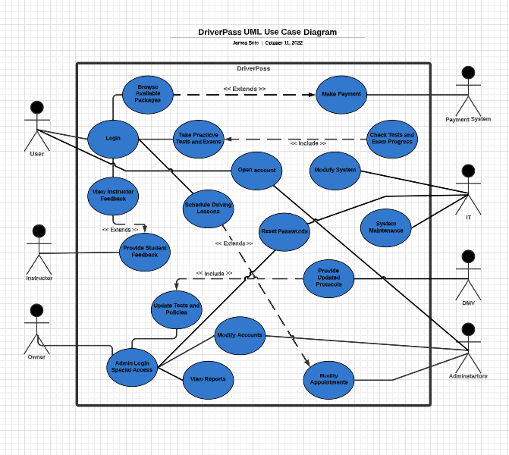
Use Case Diagram
Notes:
[Explain your diagram. Who are the different actors in the system? What are the different use cases? How did you account for DriverPass’s needs in your design? In your explanation, keep your audience in mind. Avoid the use of terms like “actors” and “use cases” in your explanation.]
For this diagram we have the many users that will interact with your system. The users that are interacting with your system are: your payment system where the customer will have the ability to make a payment, your instructors that will provide student feedback after every driving lesson, the owner who will have access to the entire system and able to update the information provided by the DMV, view reports, modify accounts, reset passwords, and update the tests and exams, we then have the administrator who will be able to create and open an account, have access to modify accounts and modify appointments, we have your IT dept who will perform system maintenance, reset passwords, and modify the system, and finally we have the customer who will be able to open an account, login into their account, schedule driving lessons, view the instructor feedback, take exams and tests and make payments. As you could see the entire system is catered to meet all of your needs and provide the user with every resource to ensure they are successful, which is DriverPass’s goal.

Slide 5
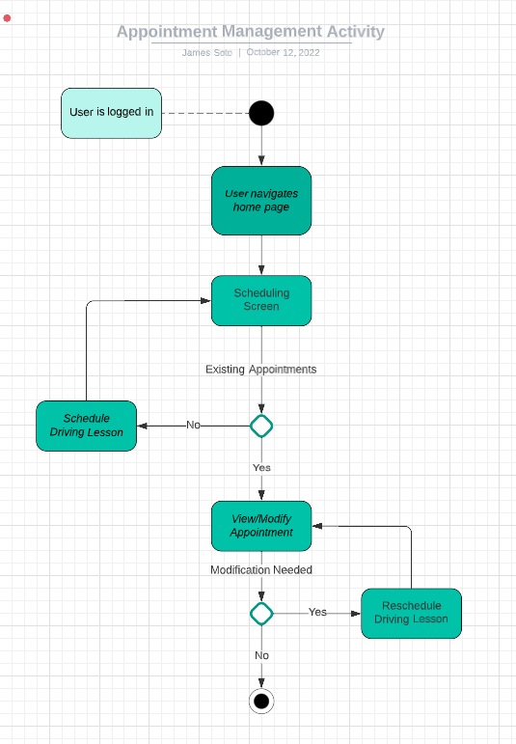
Activity Diagram
Notes:
[Explain your diagram. Which use case are you breaking down? What are the steps for this use case? How did you account for DriverPass’s needs in your design? In your explanation, keep your audience in mind. Avoid the use of technical terms such as “nodes,” “control flows,” and so on.]
I am breaking down the appointment management activity. This activity is at the heart of one of the many features we will be including in the finished product. Once the user logs into your web application, they will be sent to DriverPass’s home screen where they will navigate throughout the page and select an action. In this activity the action is to manage appointments. Once our user navigates to the scheduling screen the system will determine of the user has existing appointments or not. If they do have a scheduled appointment, the user will be able to see those appointments and could modify or reschedule the appointment. IF the user does not have an existing appointment the system will prompt them to schedule an appointment. After the user schedules, views or modifies their appointment the activity comes to an end.

Slide 6
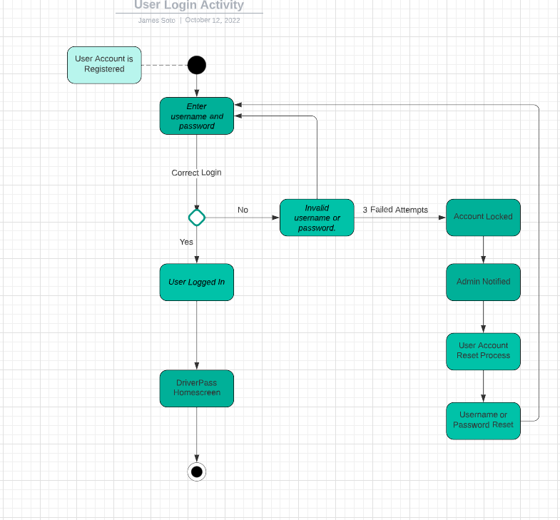
Activity Diagram
Notes:
[Explain your diagram. Which use case are you breaking down? What are the steps for this use case? How did you account for DriverPass’s needs in your design? In your explanation, keep your audience in mind. Avoid the use of technical terms such as “nodes,” “control flows,” and so on.]
I am breaking down the user login activity where the user is prompted to login when accessing your website. If the user does not have an account, they will need to register and create an account. Once a user has a valid account the user uses their login credentials to access the web application. The first step is for them to enter their username and password, if they enter the correct credentials, they are redirected to the home screen, if the credentials are wrong, they are prompted to enter them again. If they fail to enter the correct credentials after 3 tries, the account becomes locked and the admin team is notified, as requested. The admin team will start the process of account recovery and the user will once again be prompted to enter their username and password to gain access to the home page. This activity fills one of DriverPass’s needs with how we will secure their application and also how the user will be allowed to access their account.

Slide 7
Security
For the user to login they will need a username and password.
Successful entries of username and password will then be asked to provide the 2-factor authentication code which will be set up with the users email and/or phone number.
This enables 2 layers of protection for each user.
To secure the connection and data exchange between the client and server I would use a SSL implementation.
SSL is a security protocol that secures communication between over a network. SSL works by authenticating clients and servers using digital certificates and by encrypting/decrypting communication using unique keys that are associated with authenticated clients and servers.
To protect against brute force hacks, the IT dept should enable 2-factor authentication, advanced user passwords with long strong combinations, limit the amount of login tries and lockdown the account after excessive login attempts.
Any account that has excessive amounts of login attempts will be locked and reported to the IT team and Management.
We will set up passive back end 256-bit encryption
IT will remove any unused accounts that have been inactive for a certain amount of days, agreed upon by DriverPass.
Notes:
[How did you consider security in your design? In your explanation, keep your audience in mind by avoiding the use of technical terms.]
Let’s get into security.
We know security plays a major role in a company's success. To protect against hacks, brute force attacks, and data leaks we wanted to implement multiple layers of protection to both the company and the users. We believed that having a 2-factor authentication system in place would have the biggest impact. We would also secure the servers using SSL which is a security protocol that secures the communication between the client and the server. We will also encrypt the data and have IT remove unused accounts that are inactive after a specificized amount of days. In the future we could also add biometrics authentication to mobile devices accessing the web application. This adds another layer of security due to using the on device recorded face scan or fingerprint.

Slide 8
System Limitations
The allotted time does not include for working out any bugs, errors or issues found in testing prior to the delivery of the system.
The customer wants a hands-off approach and wants the server to do all the work behind the scenes. We will have to tailor the server based on their budget and expectations, which could become a problem if the platforms require more resources, and the client does not have the budget.
The application needs to run efficiently on both mobile devices and over the web, where the resources of each device will have different affects on the application. This requires that the code be optimized to run on all platforms.
Notes:
[What are the limitations of your design? In your explanation, keep your audience in mind by avoiding the use of technical terms.]
The most glaring limitation of the system design is the allotted time we were given to complete the system. With more time our development team could have worked out any bugs, errors or issues found in our code which ultimately would provide a better overall experience to you the client but also the user.

